Slide 1
RAF: First to the Future
Classroom Resource

Slide 2
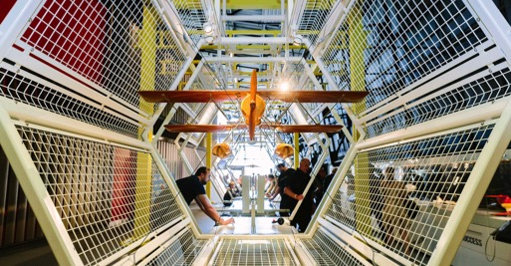
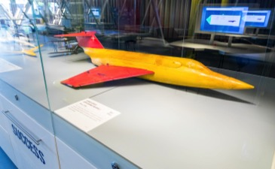
Information for Teachers
This resource is a taste of some of the issues explored within the ‘RAF: First to the Future’ exhibition at the RAF Museum, London.
It focuses on discussion and debating skills and is for use across Key Stages 3, 4 and 5.
Curriculum links can be found within the following subjects: Citizenship, Computing, Design & Technology, English, History, Politics & Government, PSHE and Science.
The content can also be used within assemblies, to facilitate careers-focused discussion or as stimulus for extra-curricular
debate clubs.
Please read the Supporting Teacher Information which accompanies these slides. Additional information can also be found in the notes section of some of these slides.

Slide 3
RAF: First to the Future

Slide 4
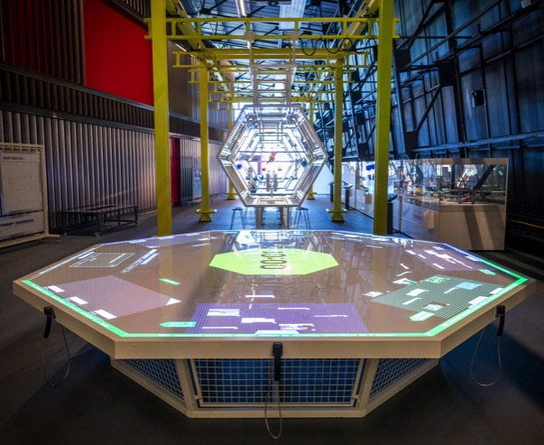
What is the RAF?
RAF stands for Royal Air Force. It is the United Kingdom’s aerial armed service and helps defend Britain from the air. It was formed in 1918 and is the oldest independent air force in the world. The RAF employs around 33,000 people.

Slide 5
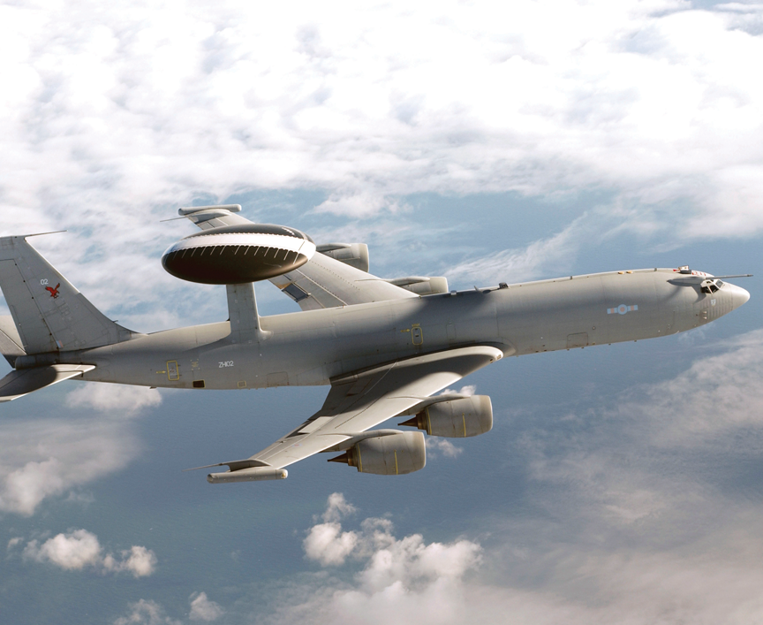
What do the RAF do?
Respond to threats
Prevent conflict
Watch the skies
Deliver aid
Work in partnership
Combat cyber threats

Slide 6
Stand Your Ground!

Slide 7
Stand your ground!
Over the next few slides you will be shown a series of statements about the UK military. Move to the left of the classroom if you are ‘For’ the statement and to the right of the classroom if you are ‘Against’ it.
Be prepared to justify your point of view if asked!
FOR
AGAINST

Slide 8
Stand your ground! – Nuclear Weapons
The UK currently has nuclear weapons
These are seen as a deterrent to stop other nations attacking
Nuclear weapons are controversial owing to their enormous destructive capabilities.

Slide 9
Stand your ground!
The UK should have
nuclear weapons
FOR
AGAINST

Slide 10
Stand your ground! – National Service
Many countries have what is called National Service
National Service is where all citizens of a country of a particular age must serve in the military
The UK had National Service from1949-1963 for those aged 18-30
Some countries now have civilian versions where, instead of people joining the military, they work in communities or for voluntary projects.

Slide 11
Stand your ground!
The UK should bring back
National Service
FOR
AGAINST

Slide 12
Stand your ground! – Frontline Women
In 2017 the RAF became the first of the UK Armed Forces to allow women on the front line in the RAF Regiment
In 2018 all positions in the UK Armed Forces became open to women including all front line roles
Before this, women were allowed to work in support and medical positions.

Slide 13
Stand your ground!
Women should be allowed
to serve on the front line
FOR
AGAINST

Slide 14
Stand your ground! – Military Age
You can join the UK armed forces at the age of 16
Outside the military you would not be allowed to do things such as drive which you can do at 16 in the military
16 and 17 year olds are not permitted in front line combat.

Slide 15
Stand your ground!
The minimum age for joining the UK armed forces should
be raised from 16 to 18
FOR
AGAINST

Slide 16
Stand your ground! – Digital Technology
In today’s military, digital technology is more important than ever
Advances in digital technology allow for more advanced intelligence and weaponry
With greater use of digital technology comes the risk of digital and cyber attack.

Slide 17
Stand your ground!
Digital technology is the most important part of the UK’s defence
FOR
AGAINST

Slide 18
Designed to Win
The F-35 Lightning II

Slide 19
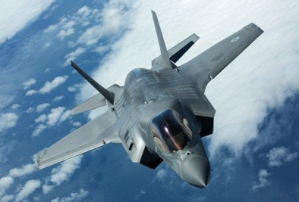
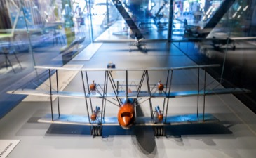
F-35 Lightning II
The RAF has always pushed the boundaries of speed, reach and height to gain an advantage over the enemy. Many new designs have evolved over the last century that have enabled aircraft to travel faster, further, higher and lower.
Innovation remains the key to the successful future of the organisation. Most recently the RAF have worked with companies around the world to develop the F-35 Lightning II, the first production aircraft capable of both vertical take-off and landing, and supersonic flight.
The F-35 is capable of ground attack and air-to-air combat. It is also the first stealth aircraft to enter RAF service as it is able to evade enemy radar.

Slide 20
F-35 Lightning II
Game-changing technology
(01.00 video duration)
Brand new capabilities
(01:51 video duration)
The cutting-edge helmet
(00:33 video duration)

Slide 21
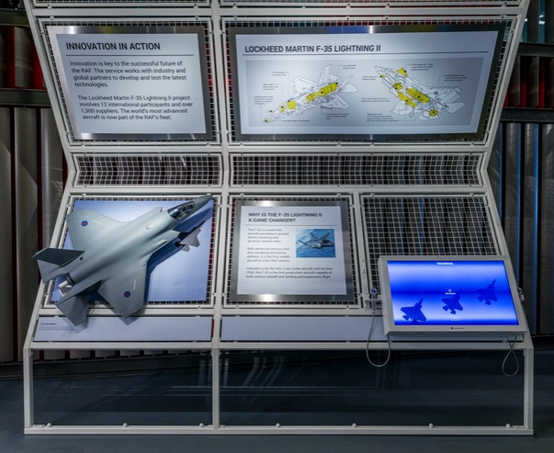
Development of F-35
The F-35 was developed with 12 international participants and over 1,500 suppliers. The other participants – including the USA, Italy and the Netherlands – will also acquire F-35 aircraft. Each aircraft costs around £80 million to build and the entire development cost is expected to be well over a trillion pounds. The F-35 is expected to be the UK’s main strike aircraft until at least 2040.

Slide 22
Designed to Win: Part 1
On the next slide you will find a list of some of the most ground-breaking elements of the F-35’s design. In pairs or small groups, discuss what each feature could be used for.
Be ready to explain your choices.
Notes:
You may wish to use the accompanying ‘Designed to Win’ student handout for this activity (Slide 37)

Slide 23
Supersonic flight | Vertical take off and landing | Multi-role – designed for ground attack and air-to-air combat | Continuous all-direction target detection and attack (it does not need to be physically pointing at its target to be successful)
Stealth technology to make plane less visible to the enemy (it cannot be picked up by radar) | Helmet linked to sensors on the aircraft allows the pilot to ‘see through the plane’ | High-speed data networking – collects and shares information immediately with allies on ground, in the air or at sea | Electronic attack capabilities – can locate and track enemy forces, jam radio frequencies, attack networks and suppress enemy radars
Notes:
You may wish to use the accompanying ‘Designed to Win’ student handout for this activity. (Slide 37)
Supersonic Flight – faster than the speed of sound
Vertical take-off and landing – taking off and landing straight up or down without the need for runways. This is useful on ships, urban areas, forest clearings etc.
Multi-role – can be used against air and ground targets
Continuous all-direction target detection and attack – targets can be detected 360 degrees around the aircraft and the weapons can lock on and track targets without having to point the aircraft at the target as is conventional
Stealth technology – radar signals are deflected in different directions or absorbed making the F35 look no bigger than a golf ball on radar
Helmet linked to sensors on the aircraft allow pilot to ‘see through the plane’ – works like live AR technology. Cameras on the outside of the aircraft are streamed to the helmet to give an all-round view
High-speed data networking – collects and shares information immediately with allies on ground, in the air or at sea. This helps to stay connected and keep better control of the overall battlefield
Electronic attack capabilities – can locate and track enemy forces, jam radio frequencies, attack networks and suppress enemy radars – as well as being less visible to radar the F35 can shut down or confuse enemy radar

Slide 24
Designed to Win – Part 2
Now you have thought about each of these features it is time to decide what you think would be most important.
Rank each of the features from most to least important.
Be ready to explain your choices.
Notes:
You may wish to use the accompanying ‘Designed to Win’ handout for this activity. (Slide 36)

Slide 25
Persuade Me

Slide 26
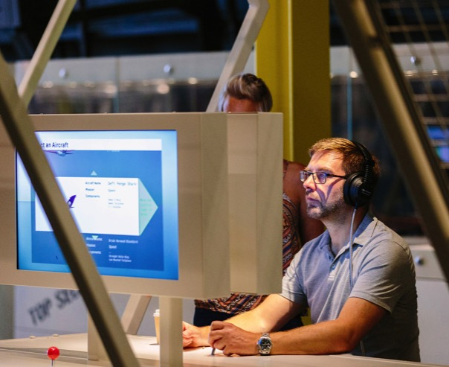
Precision Strike
The F-35 has been designed for precision strike warfare. Precision strike technology uses laser-guided missiles and GPS to incapacitate a specific target at the first attempt. This minimises the risk to civilians. Precision strike relies on accurate intelligence to select the correct target.

Slide 27
Persuade Me
On the following slide you will find the profile of a potential target for precision strike using a F-35.
Get into groups of five. You are a command unit in the RAF. Each unit must come up with an analysis of whether to carry out a strike or not. Consider the ethical and legal issues involved in such a decision. Take into account the pros and cons that would decide the fate of the target.
At the end we will take a vote to see whether your units would order a strike or not.

Slide 28
Persuade Me - Profile
Name: Unknown – Alias ‘The Chief’
Age: 38
Nationality: Former British National
Profile: ‘The Chief’ is suspected of heading up a known international criminal organisation responsible for the kidnap of a British journalist reporting on regional tensions in an active warzone. In exchange for the journalist, the organisation is demanding the release of their second-in-command who is currently serving a sentence in a high security prison in the UK.
Supporting Intelligence:
- Unrelated Facebook correspondence between ‘The Chief’ and known members of criminal organisation
- CCTV showing ‘The Chief’ and kidnap victim at petrol station
- Meta data showing WhatsApp messages between ‘The Chief’ and known members of criminal organisation (contents unknown)
- Previous criminal record for financial crimes, drugs offences and armed robbery
- Network data showing current location of ‘The Chief’s’ phone, near a busy market close to where the kidnap victim went missing
- Heat sensors showing high human presence at same location.
Notes:
Evidence suggests the suspect is at the location pointed out by the intelligence and that they are an eligible target. The issue is that the target appears to be at a busy market location where civilian presence will make the decision to strike more of an ethical dilemma.

Slide 29
Persuade Me
Count up the number of ‘For’ and ‘Against’ votes in the room to decide the fate of our potential target.
How did it feel to be involved in this decision?
What ethical issues did your discussion raise?

Slide 30
Full Circle

Slide 31
Full Circle
Sit in a circle and prepare to debate the statement revealed on the next slide. The first person says ‘Yes, because…’ and the second person says ‘No, because…’. Carry on around the circle until everybody has had a chance to speak. If you get stuck towards the end of the circle it’s OK to develop somebody else’s idea rather than adding anything new (e.g. If your debate statement was ‘The UK should bring back national service’ you could say ‘Yes, because as Ramisa says some young people in this country don’t know how lucky they are and I think this would teach them respect and discipline’)

Slide 32
Full Circle
The F-35 makes
the UK more secure

Slide 33
Full Circle – extension statement
There is no way to justify
spending £80 million of public money on one F-35 jet

Slide 34
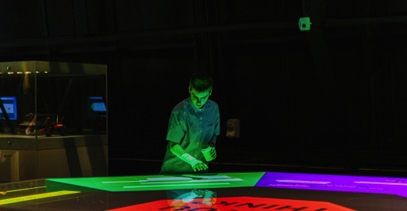
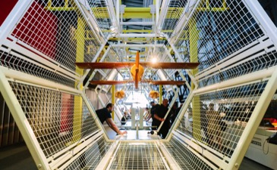
At the RAF Museum
If you have enjoyed the activities in this resource you can find out more about the issues raised by visiting our ‘RAF: First to the Future’ exhibition, which examines in more detail how the RAF use new technologies to stay ahead.
Supplement your exhibition visit with a 60-minute facilitated workshop in our purpose-built Interactive Debate Space [link to video] where a member of our Learning team guides students through a debate which asks: Are robots taking over the world? Should drones be allowed in our skies? Should we be worried about AI? (£60 per session)
Book online at the following URL: https://www.rafmuseum.org.uk/london/schools/school-visit-booking.aspx

Slide 35


Thanks for downloading
With thanks to Sam Leather, RAF Museum volunteer, for assistance with this resource

Slide 37
Task 2 Rank each of the items from the table on the left in a list from most to least important. Be prepared to justify your responses. Most Important Least important
Task 1 Discuss what each of the technologies listed below would be used for, and their importance to the pilot and “mission control”.
A. Supersonic flight | B. Vertical take off and landing | C. Multi-role The F35 is designed for ground attack and air-to-air combat | D. Continuous all-direction target detection and attack The F35 does not need to be physically pointing at its target to be successful
E. Stealth technology Makes the plane less visible to the enemy (it cannot be picked up by radar) | F. Helmet Linked to sensors on the aircraft - allows the pilot to ‘see through the plane’ | G. High-speed data networking Collects and shares information immediately with allies on the ground, in the air or at sea | H. Electronic attack capabilities Can locate and track enemy forces, jam radio frequencies, attack networks and suppress enemy radars
Designed to Win
Notes:
‘Designed to Win’ student handout

